Slide 1
Introduction to High Performance Computing PART 3 HPC @ IT4Innovations BUILDING CODE ON THE CLUSTER
Jakub Beránek

Slide 2

Outline
Remote development
Modules
Available software on clusters
Common toolchains (C/C++, Python)
Containerization
Gitlab, CI

Slide 3
Local vs Remote development
Local code development is much easier
Remote IDE - VSCode/Clion/... offer remote development over SSH
The server compiles code on the cluster, but the UI runs on your PC
sshfs - treat the remote filesystem as a local one
git – synchronize code through a repository

Slide 4


Building Code and Dependencies
You must build your program and its dependencies for your target cluster
e.g. Karolina runs on Rocky Linux 8
You DO NOT have admin privileges on the cluster
Standard package managers (like yum/apt) cannot be used
You have several options how to compile your code and its dependencies
Use the available pre-installed modules
Compile your code and all its dependencies from scratch
Use Apptainer containers
Use Spack (HPC package manager)
...
All further command examples will assume execution on a login node
You can find more information here

Slide 5
Using Lmod modules
Each IT4I cluster has its own set of pre-installed modules available for immediate use
Module
Is a set of binaries, libraries, header files, …
Has a set of modules that it depends on
Might have several available versions (Python/2.7.9 vs Python/3.6.1)
Might have a specific toolchain (GCC vs Intel toolchain)
To use a module, you have to load it
Loading a module modifies environment variables (PATH, LD_LIBRARY_PATH)
This enables executing module binaries and linking to module libraries

Slide 6
Available modules
Language toolchains (Python, Java, C#, …)
C/C++ compilers (GCC, Clang, Intel C++ compiler, CUDA nvcc, …)
Communication libraries (MPI, GPI-2, ...)
Parallel debuggers and profilers (Allinea Forge, VTune, PAPI, Scalasca, Score-P, Vampir, …)
Parallelized libraries (FFTW, PETSc, Trilinos, Octave, ...)
Specialized software for chemistry, bioinformatics, physics, visualization, 3D rendering, …
GROMACS, Gaussian, Molpro, NWChem, Orca, Phono3py, OpenFOAM, ParaView, ...
You can also create your own modules or ask support to install new modules for you​
Modules are defined using EasyBuild​
If you find a module that is not working, contact support
Full list of modules available at IT4I clusters is located here

Slide 7
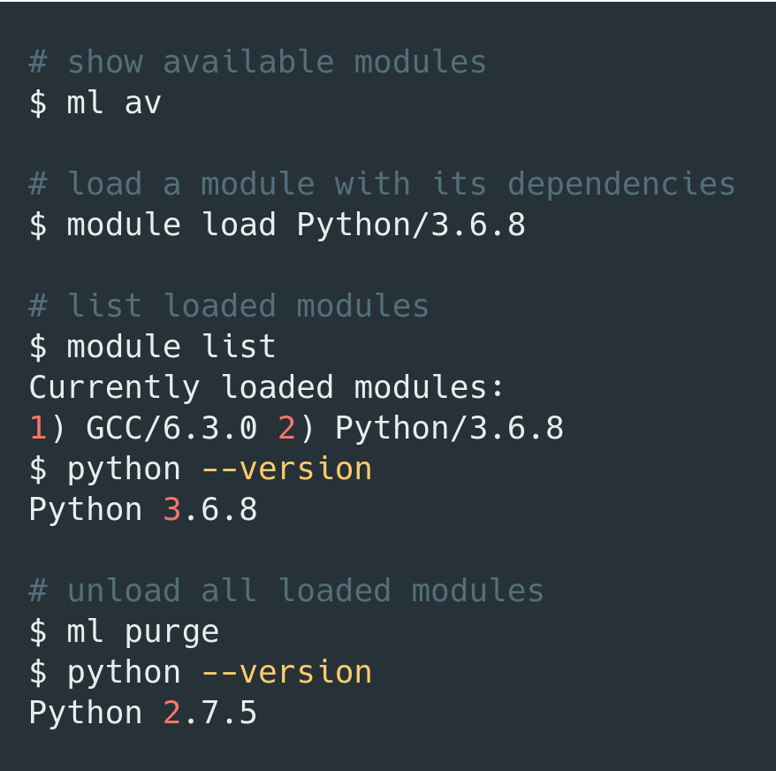


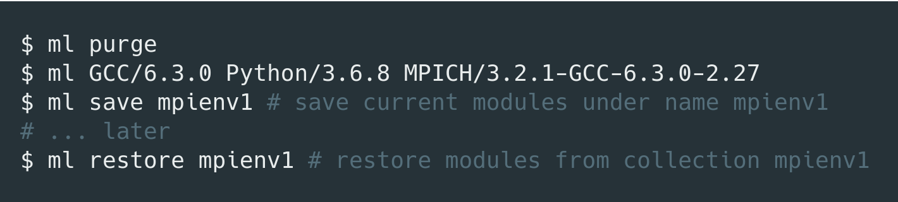
Using LMOD
Useful hints
Always load specific versions of modules to avoid surprises
ml GCC/6.3.0
ml GCC
Module load order matters (because of conflicting dependencies)
ml A B might produce different results than ml B A
Save module combinations that you commonly use into collections
Filtering modules
$ ml spider <package>
ml command also provides tab completion
ml command is case sensitive
Match module toolchains (GCC vs Intel)
Do not forget to load correct modules in your Slurm job script!

Slide 8
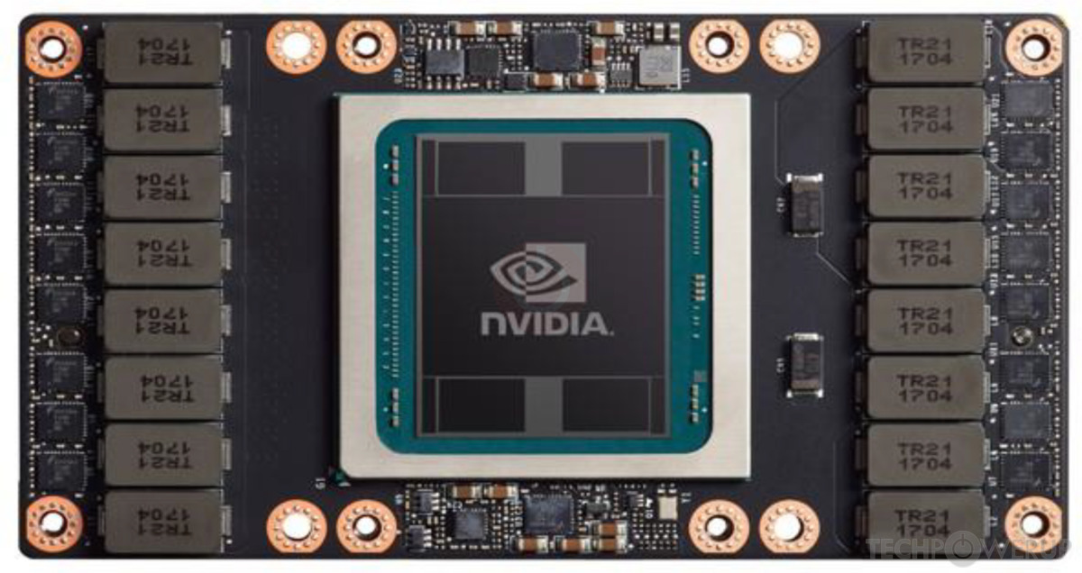
Using GPUs
Available clusters with GPUs:
Karolina: 72 nodes, 8 A100 (40 GiB) GPUs per node
Barbora: 8 nodes, 4 V100 (16 GiB) GPUs per node
DGX: 16 V100 (32 GiB) GPUs
By default, Karolina jobs will allocate a single GPU
Check if your tool has support for Multi-GPU setups
Use prepared modules:
$ ml CUDA/12.2.0
$ ml av nvhpc
When loading multiple GPU modules, match their versions!
$ ml CUDA/12.2.0 cuDNN/8.9.2.26-CUDA-12.2.0

Slide 9
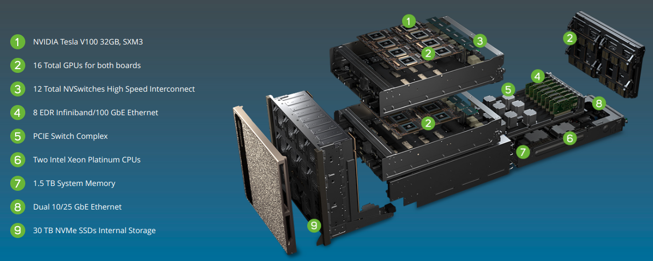
DGX-2
Has a dedicated PBS queue
Accessible from Barbora (qdgx queue)
Check if your tool has direct support for it
Dask-DGX

Slide 10
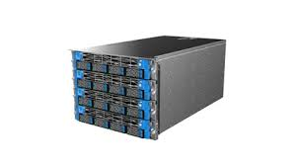
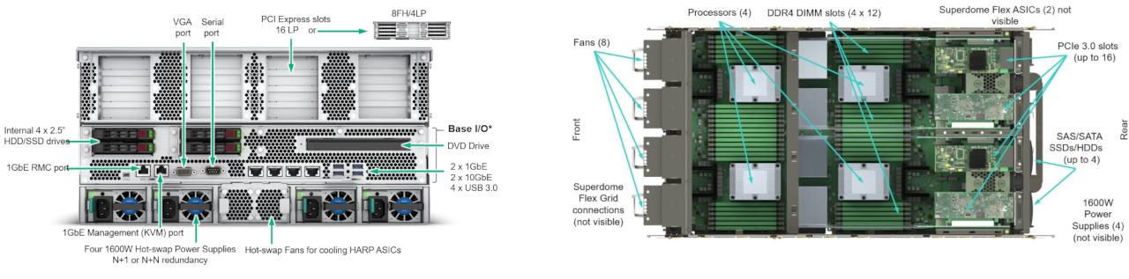
Fat nodes
Nodes with a large amount of RAM
Useful for programs that are hard to distribute
Use the qfat queue
Karolina
Data analytics node – 768 cores, 24 TiB RAM
Barbora
BullSequana X808 – 128 cores, 6144 GiB RAM

Slide 11
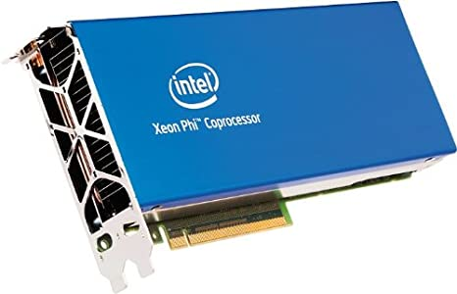
Intel MIC (Many integrated core)
Salomon has 432 MIC accelerated nodes
Intel Xeon Phi 7120P - 61-core accelerator, Knight Corner uarch
1 TFLOP in double precision
Use the qmic queue
Mostly unused, lacks software support
Available for specialized use cases

Slide 12
compiling C/C++ PROGRAMS
Load necessary modules
Compiler (e.g. GCC/6.3.0)
Dependencies (e.g. MPICH/3.2.1-GCC-6.3.0-2.27)
Build system (e.g. CMake/3.16.2)
Build your program on a login node
Once your binary is built, it can be accessed by all cluster nodes using the shared filesystem
3. Adjust your PATH/LD_LIBRARY_PATH environment variables
PATH – directories where binaries are located
LD_LIBRARY_PATH – directories where shared dynamic libraries are located
If a dependency is not available as a module, you must compile it yourself

Slide 13
C/C++ compilation flags and tips (gcc)
Make use of optimizations and available instruction sets
Karolina has AVX2 (256-bit vectorization)
Barbora has AVX-512 (512-bit vectorization)
Useful flags
Optimizations: -O2, -O3
Benchmark what works best for your code
Use native instruction set: -march=native
Fast floating point math (at the cost of precision): -ffast-math
Link-time optimization: -flto
Profile-guided optimization: -fprofile-generate, -fprofile-use
Enable OpenMP: -fopenmp
Tip: you can check generated assembly at godbolt.org

Slide 14
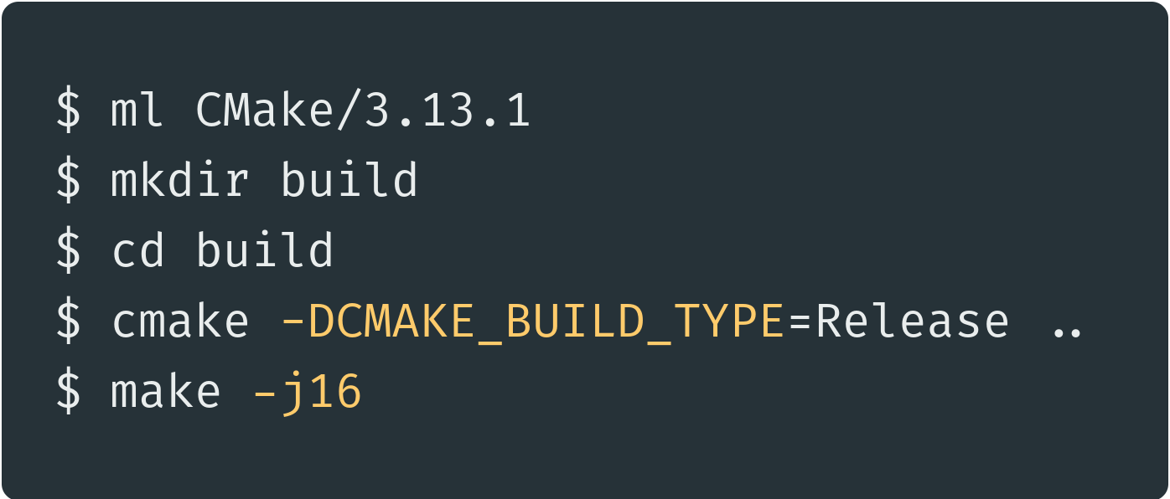
COMMON C/C++ BUILD SYSTEMS
Makefile
Simply run make in the project directory
CMake
Load CMake module
Create build files inside a build directory
Invoke Make (or other build systém, e.g. Ninja) to build the project
CMake tip: use –DCMAKE_INSTALL_PREFIX=<dir> so that you can use make install

Slide 15
MPI
Choose desired MPI implementation and module
MPICH, OpenMPI, Intel MPI (impi)
Keep the same impl. and version for compilation and execution
Compile using mpicc or mpicxx
Run your program
$ mpirun -n 2 <program>
More information about MPI in a later section
There is also MPI4Py for Python

Slide 16
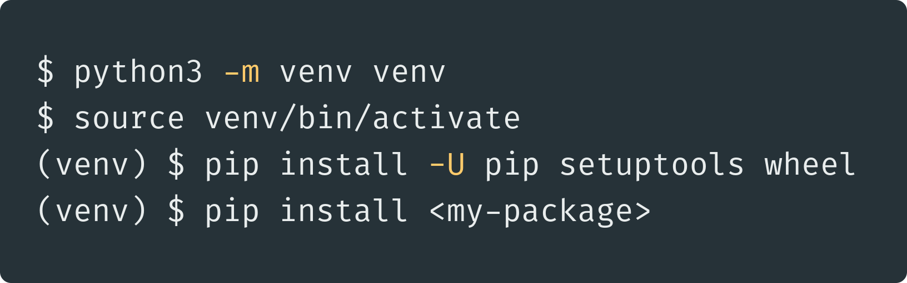
Python
Works mostly out-of-the-box on all clusters
Make sure to load the same Python version module
When setting up your environment
Inside Slurm jobs
Avoid using system/user Python, use virtual environments instead
Puts all your dependencies inside a single directory
venv usage example
conda/mamba for precompiled packages

Slide 17
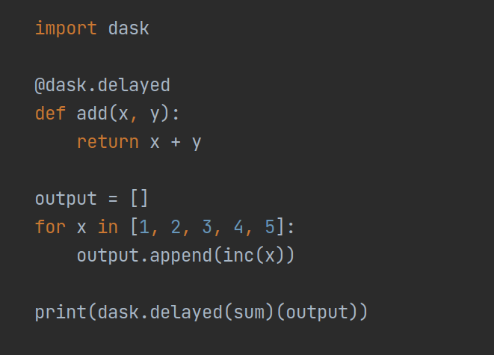
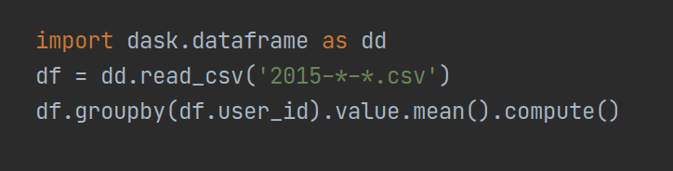
Python (performance)
Many useful cluster/HPC frameworks exist
Parallelize computation or put it on GPU with a few lines of codes
Distributing computation: Dask, Ray, PySpark, HyperLoom
GPU-acceleration: RAPIDS (cuDF, cupy), numba
Python compute bound programs can be accelerated by PyPy or Cython
Profile performance using py-spy or Scalene

Slide 18
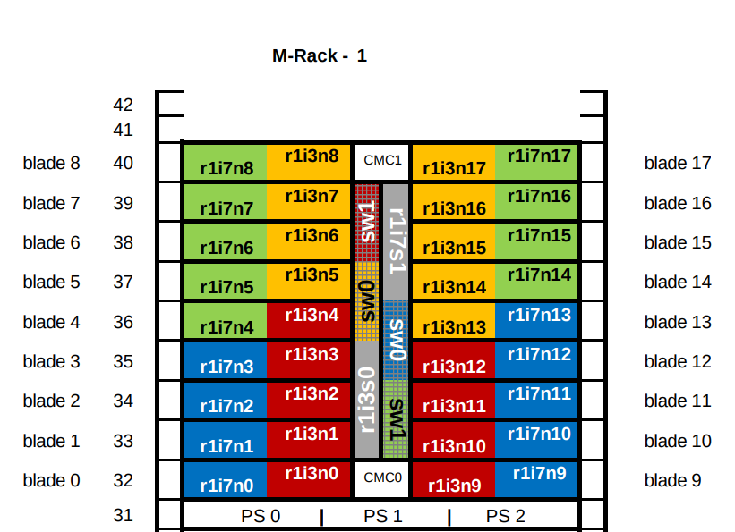
Networking
Computing nodes are connected using InfiniBand
Anselm
Fat tree topology, 40Gb/s
Salomon
7D enhanced hypercube topology, 56 Gb/s
Peak: 2 GiB/s TCP, 3.6 GiB/s InfiniBand
Barbora
Fat tree topology, 100 Gb/s
Node name is an address in network topology
Computation vs communication ratio

Slide 19
Distributed computing
List of nodes inside a job available in PBS_NODEFILE
SSH can be used to connect to them
Check used network interface
Usually auto-detected correctly, but not always
InfiniBand (ib) vs TCP (eth)

Slide 20
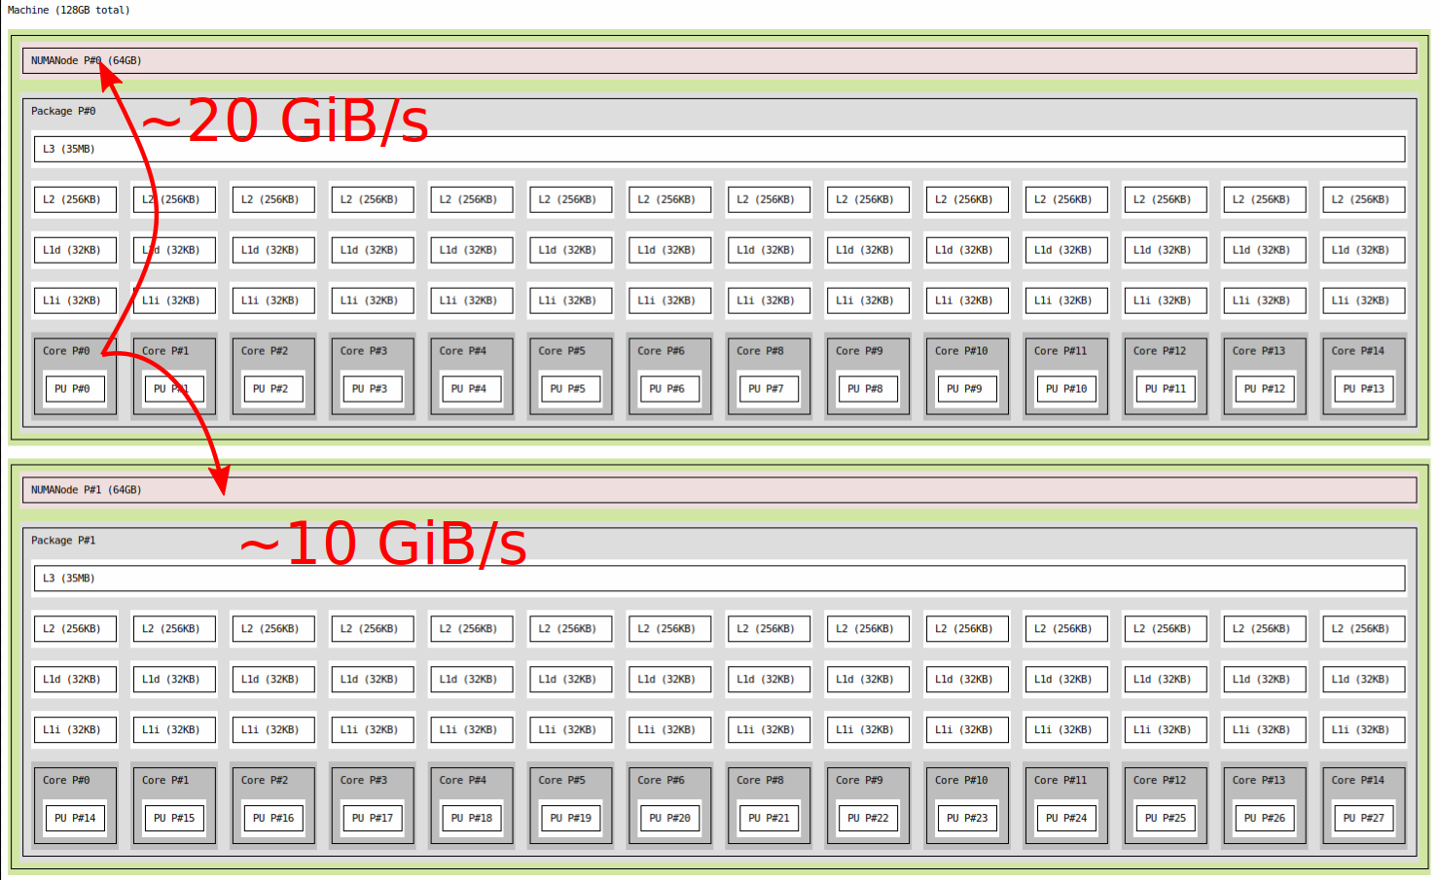
NUMA (non-uniform memory access)
NUMA node - set of cores and memory with the "same distance" to each other
Memory access to a different ("farther") node is slower!
Salomon has 2 NUMA nodes (each has 12 cores and 64 GiB RAM)
Barbora has 2 NUMA nodes (each has 18 cores and 93 GiB RAM)
Check NUMA topology: $ ml hwloc && ls topo --no-io --output-format txt

Slide 21
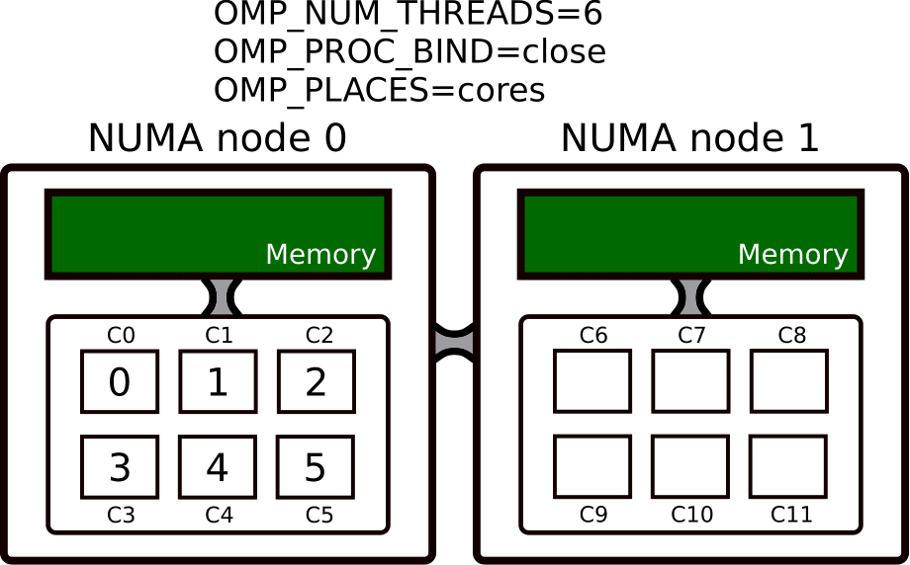
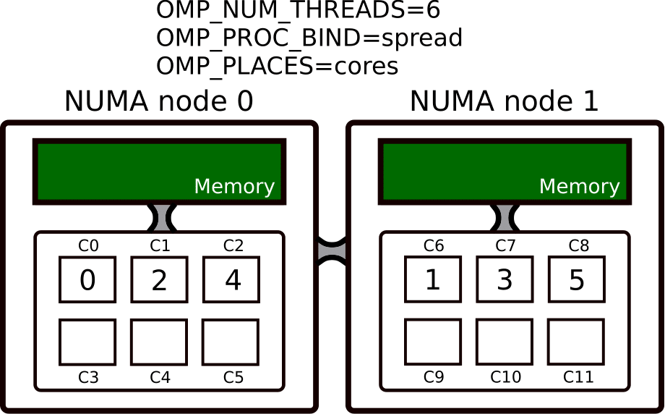
NUMA Placement
You can control on which cores will your threads run
Use numactl or OpenMP binding env. variables

Slide 22
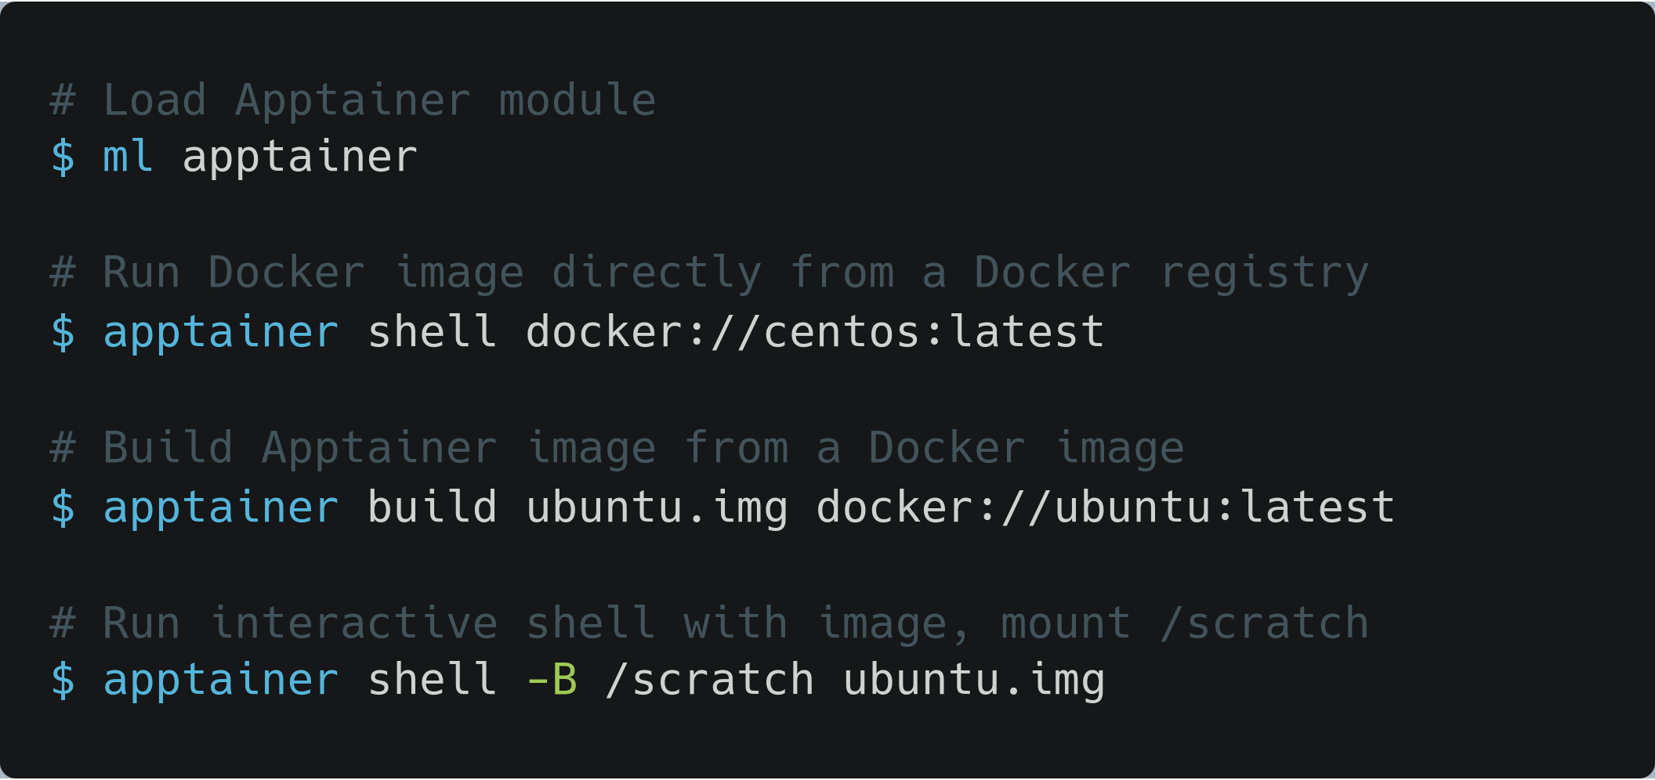
Containerization using Apptainer
Containers allow you to
Prepare your code and all dependencies
Distribute them easily in the form of an archive (image)
Execute them in a sandboxed environment
Popular container solution is Docker
It cannot be used on IT4I clusters directly because of security issues
You can use Apptainer instead
Preferred deployment method on DGX-2
Nvidia containers available at NGC
IT4I helper Apptainer wrappers (https://docs.it4i.cz/software/tools/singularity-it4i/)

Slide 23
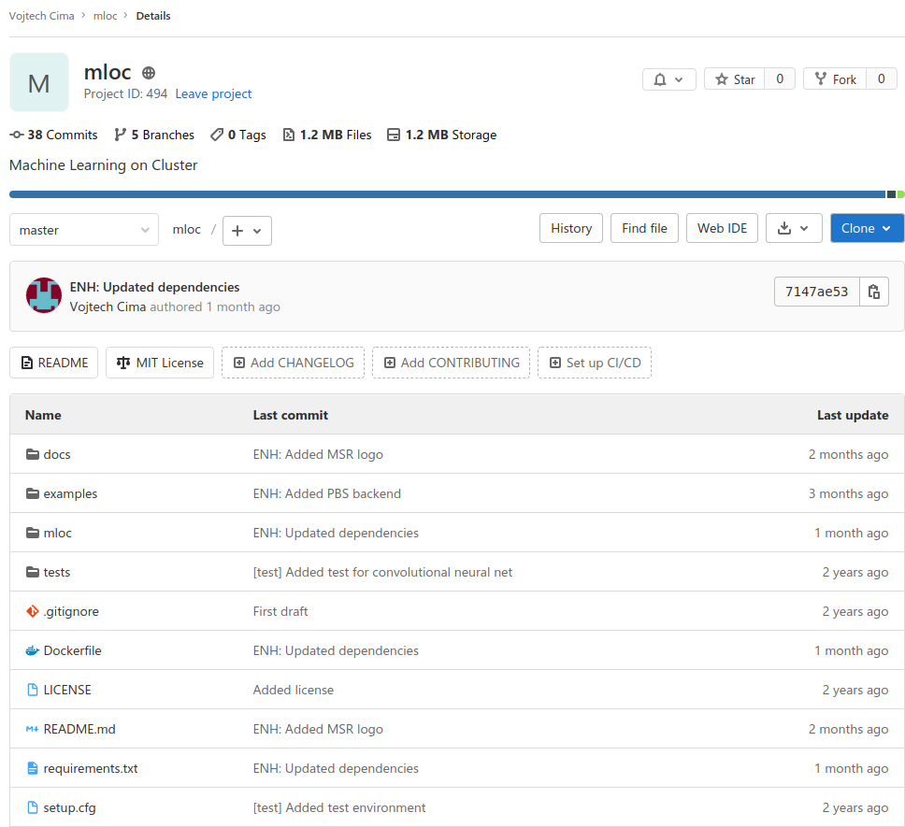
GITLAB
IT4I hosts a GitLab instance at https://code.it4i.cz
Code storage, sharing and review (repositories, pull requests)
Project management (issue tracker, wiki)
Container repository
Continuous integration

Slide 24
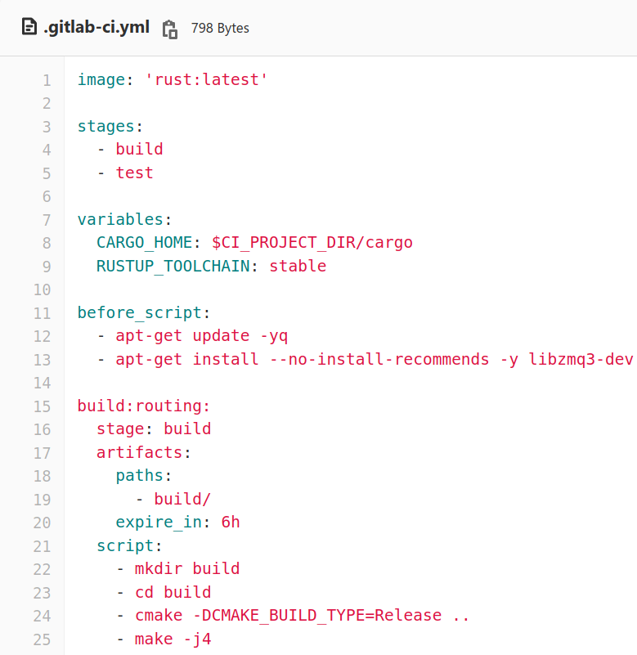
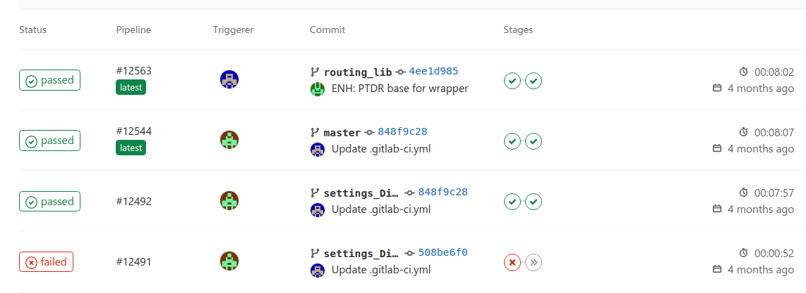
GITLAB CI (continuous integration)
Pipelines = scripts executed after a push to a repository
IT4I has 5 shared runners that can run pipelines
Check that your code was not broken by a commit
Correctness (unit tests)
Performance (benchmarks)
Code style, lints, …
Deploy built artifacts
Configured with .gitlab-ci.yml
Gitlab CI documentation can be found here

Slide 25
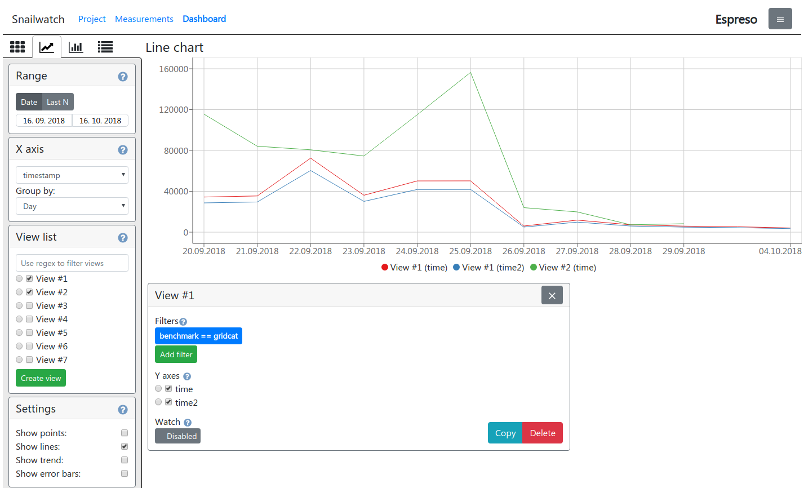
Continuous benchmarking
Snailwatch
Benchmark your code after each commit in CI, observe trends

Slide 26
Further Reading
Productivity tools workshop
Git
EasyBuild
Gitlab CI
Singularity
Lmod
kvm

Slide 27
Jakub Beránek
jakub.beranek@vsb.cz
IT4Innovations National Supercomputing Center
VSB – Technical University of Ostrava
Studentská 6231/1B
708 00 Ostrava-Poruba, Czech Republic www.it4i.cz

